Slide 1
Visualizing 2D Materials Using Multi-Layered Structures
Mariah Ellis
Dr. Lloyd Bumm
University of Oklahoma – 2026 Physics REU

Slide 2
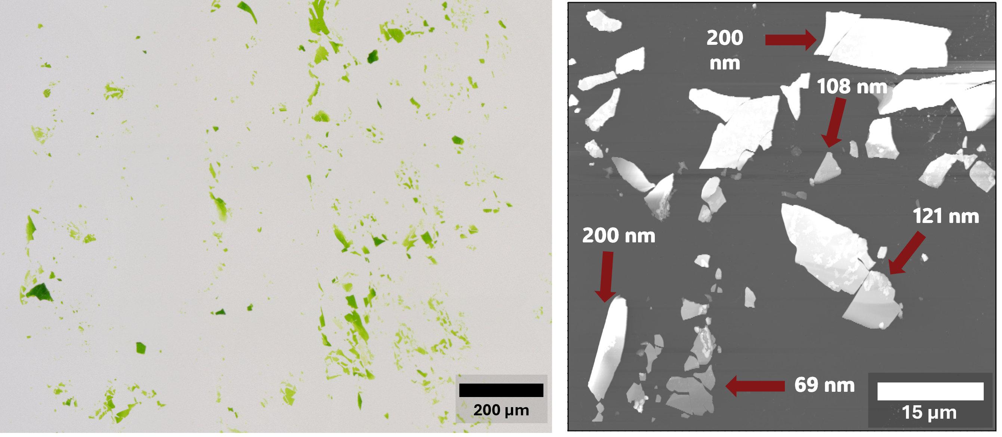
Motivation Behind Project
Wanted to make 2D, hard-to-see ultra-thin organic materials easier to see through an optical microscope.
Need to exfoliate material into thin, transparent flakes on top of a substrate.
Thinner flakes are harder to see.
AFM image takes a long time; the optical microscope is a lot quicker.
AFM Image (Atomic Force Microscopy)
Notes:
Picture took 35 minutes to take? Yes! Added “ultra-thin”/”optical microscope”

Slide 3
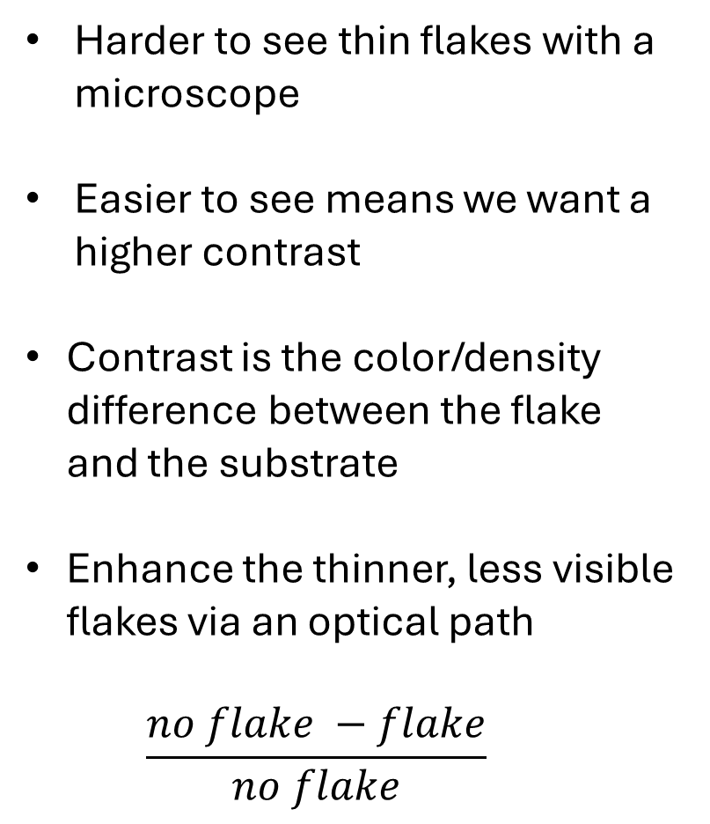
Contrast
Harder to see thin flakes with a microscope
Easier to see means we want a higher contrast
Contrast is the color/density difference between the flake and the substrate
Enhance the thinner, less visible flakes via an optical path
$$\frac{no flake −flake}{no flake}$$
Optical Microscope
Notes:
Light hitting the
Color/density. Density is darkness/lightness

Slide 4
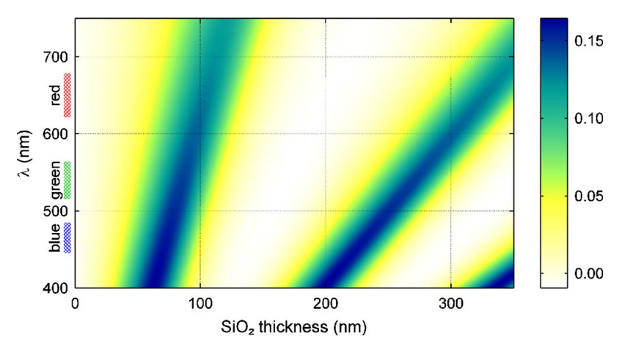
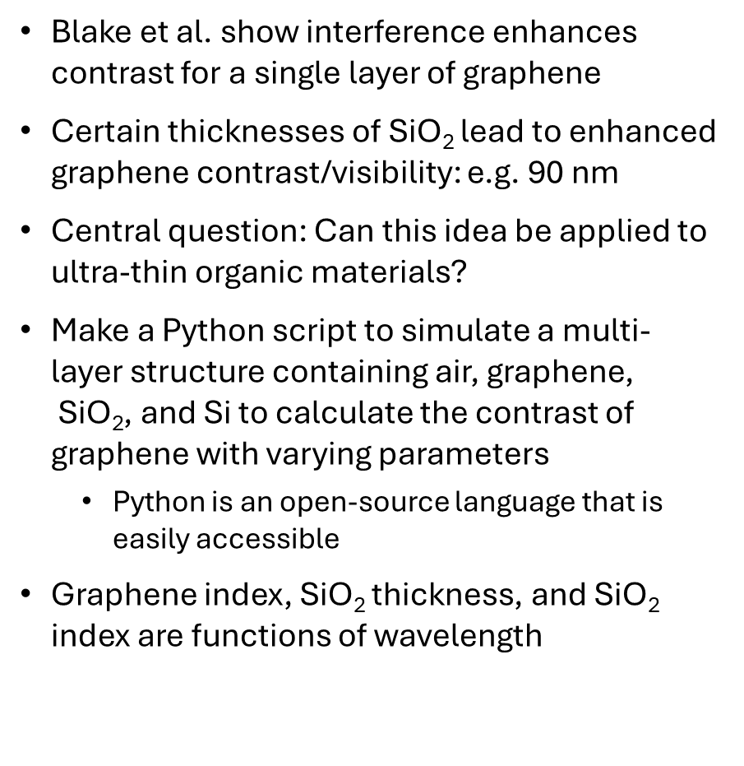
Goal
graphene
Blake et al. show interference enhances contrast for a single layer of graphene
Certain thicknesses of SiO₂ lead to enhanced graphene contrast/visibility: e.g. 90 nm
Central question: Can this idea be applied to ultra-thin organic materials?
Make a Python script to simulate a multi-layer structure containing air, graphene, $\text{SiO}\text{2}$, and Si to calculate the contrast of graphene with varying parameters
Python is an open-source language that is easily accessible
Graphene index, SiO₂ thickness, and SiO₂ index are functions of wavelength
SiO₂
Si
P. Blake, E. W. Hill, A. H. Castro Neto, K. S. Novoselov, D. Jiang, R. Yang, T. J. Booth, A. K. Geim; Making Graphene Visible. Appl. Phys. Lett. 6 August 2007; 91 (6): 063124. https://doi.org/10.1063/1.2768624
Notes:
Python is an open-source language that is easily accessible

Slide 5
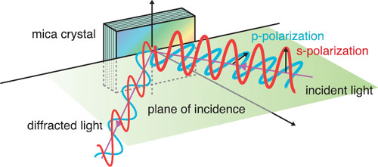
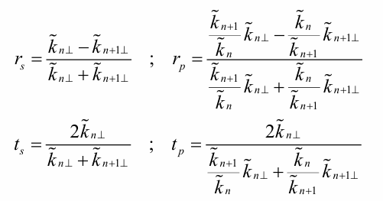
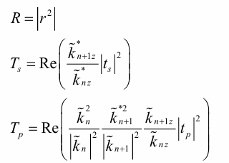
Reflection and Transmission Coefficients Fresnel Equations
Explain how the reflection and transmission of light are affected when changing mediums
Amplitude coefficients r and t: magnitude/phase
Power coefficients R and T: how light moves through
medium
In terms of the wave relative vector
Notes:
Amplitude coefficients: contain magnitude and phase
Power coefficients: explain how the light reflects and is transmitted as wave moves through an interface

Slide 6
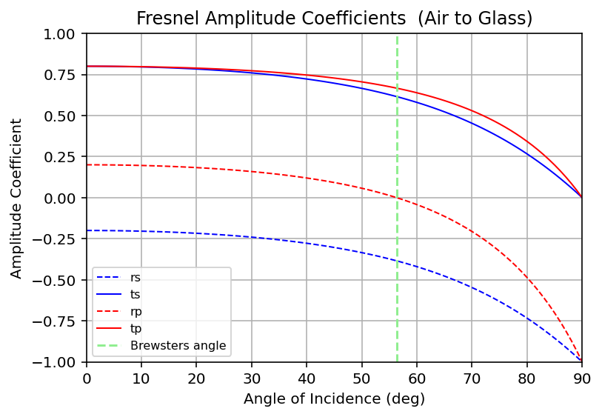
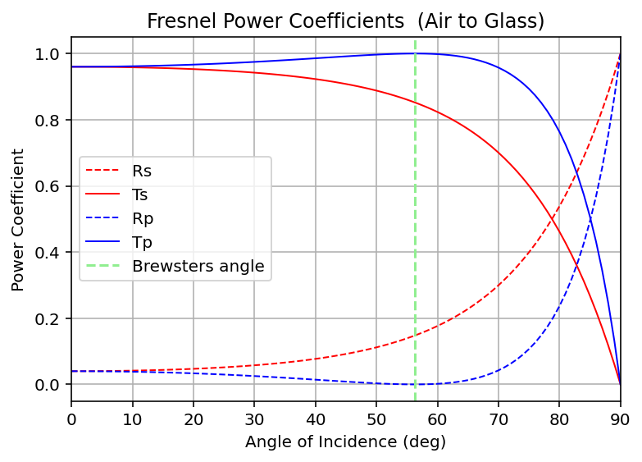
Testing Fresnel Equations/Coefficients
Graphs made by me!
Started with only two layers: air → glass
Calculates the reflection and transmission Coefficients at each interface
Notes:
There are two types of coefficients : s polarization and p polarization
Point out 4% R at normal incidence. R approaches 100% at grazing incidence. Rp is zero at Brewetser’s angle

Slide 7
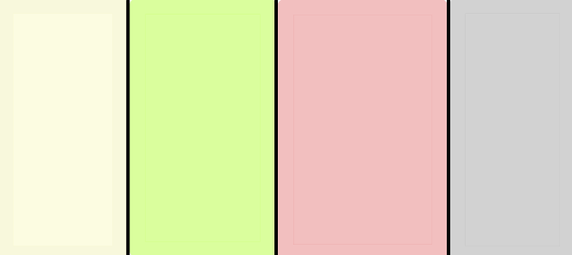








Multi-Layered Structures
$$n_{0}$$
$$n_{1}$$
$$n_{2}$$
$$n_{3}$$
$$E_{incident}$$
$$E_{transmission}$$
$$E_{reflection}$$
$$E_{∞}$$
Multiple layers of mediums with different refractive indexes.
Must account for all incidence, transmission, and interference.

Slide 8
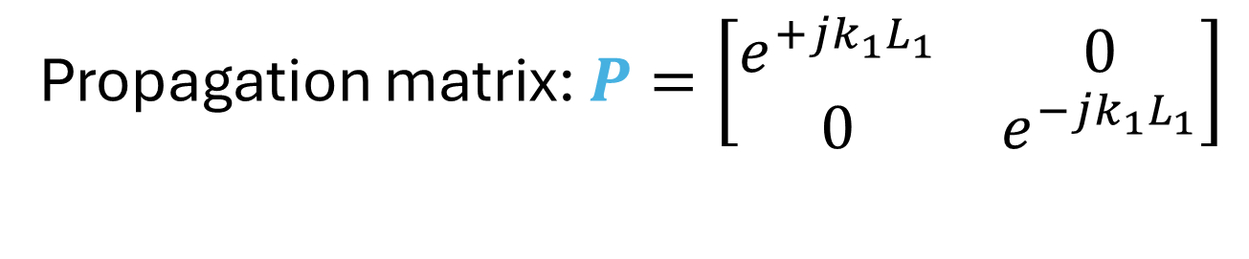


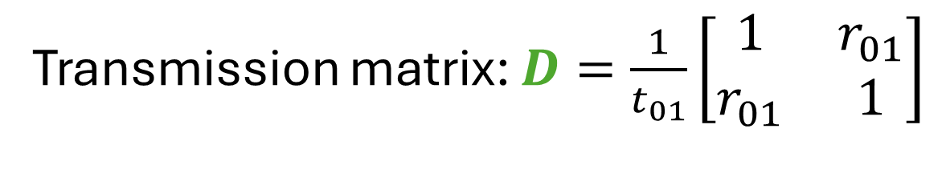






Transfer Matrix
$$n_{0}$$
$$n_{1}$$
$$n_{2}$$
$$n_{3}$$
$$R$$
$$R R R R R$$
COULD calculate this out with each individual incidence, transmission, and interference of light, but isn’t scalable.
Easier way to compute all the components in a scalable way.
$$L$$
$$L L L L L$$
$$0$$
$$0$$
$$1A 1B 2A 2B 3A$$
$$1A 1B 2A 2B 3A$$
Transmission matrix: $D=\frac{1}{t_{01}}\left[\begin{matrix}1 & r_{01} \\ r_{01} & 1\end{matrix}\right]$
$$M=D_{23}P_{2}D_{12}P_{1}D_{01}$$
Propagation matrix: $P=\left[\begin{matrix}e^{+jk_{1}L_{1}} & 0 \\ 0 & e^{−jk_{1}L_{1}}\end{matrix}\right]$

Slide 9




Transmission Matrix
Propagation Matrix
The in-between of mediums
What the Fresnel equations calculate
Earlier graphs calculate one transmission matrix
The individual medium
Dependent on thickness of medium and angle of incidence
Thickness of first and last medium is semi-finite
$$n_{0}$$
$$n_{1}$$
$$n_{2}$$
$$n_{3}$$

Slide 10
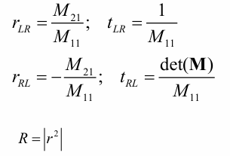

Scattering Matrix
Accounts for multiple reflection, transmission, and interference.
Can calculate the reflection and transmission coefficients from the system from the resulting matrix
Specifically want the reflection coefficient (R) at normal incidence.

Slide 11
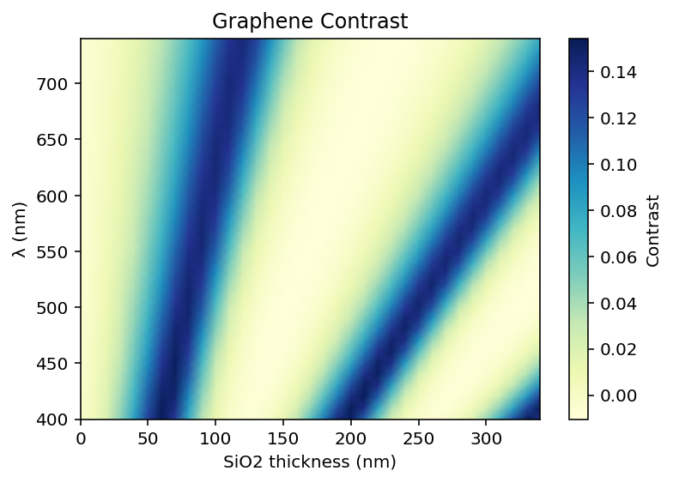
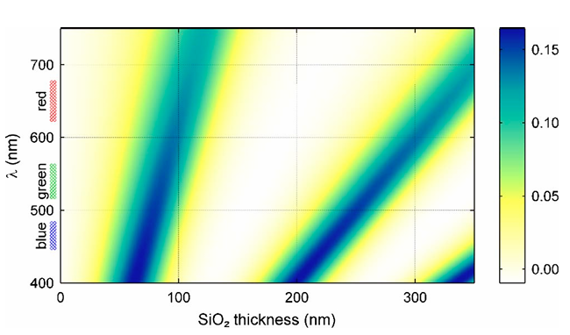
Result: Replication of Graphene Contrast
Made by me!
Successfully replicated the graph from the paper! Yay!
Used the graphene index and SiO₂ thickness both as functions of wavelength
SiO₂ at 90 nm is optimal for graphene contrast

Slide 12
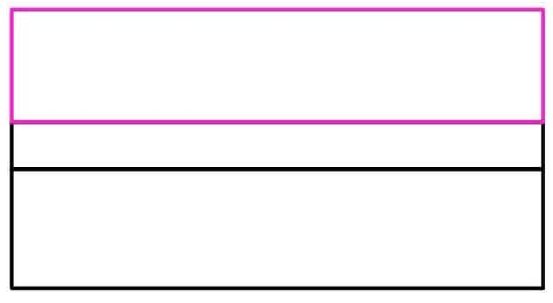
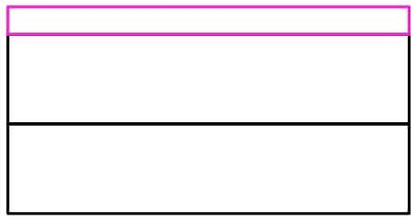
Extend Blake et al. to Thicker Graphene Layers
Changing Graphene
Graphene = 0.34 nm
SiO₂ = 90 nm
Changing SiO₂
Si
Si
Made by me!
Know that 90 nm SiO₂ is where the graphene contrast is at a peak
Can make SiO₂ thickness constant to see how changing graphene’s thickness affects the contrast.

Slide 13
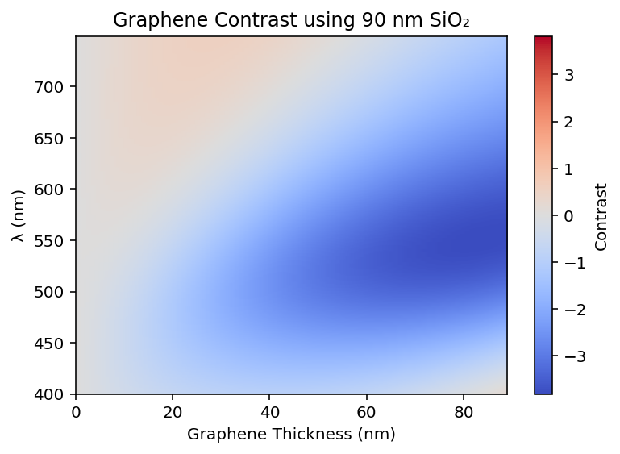
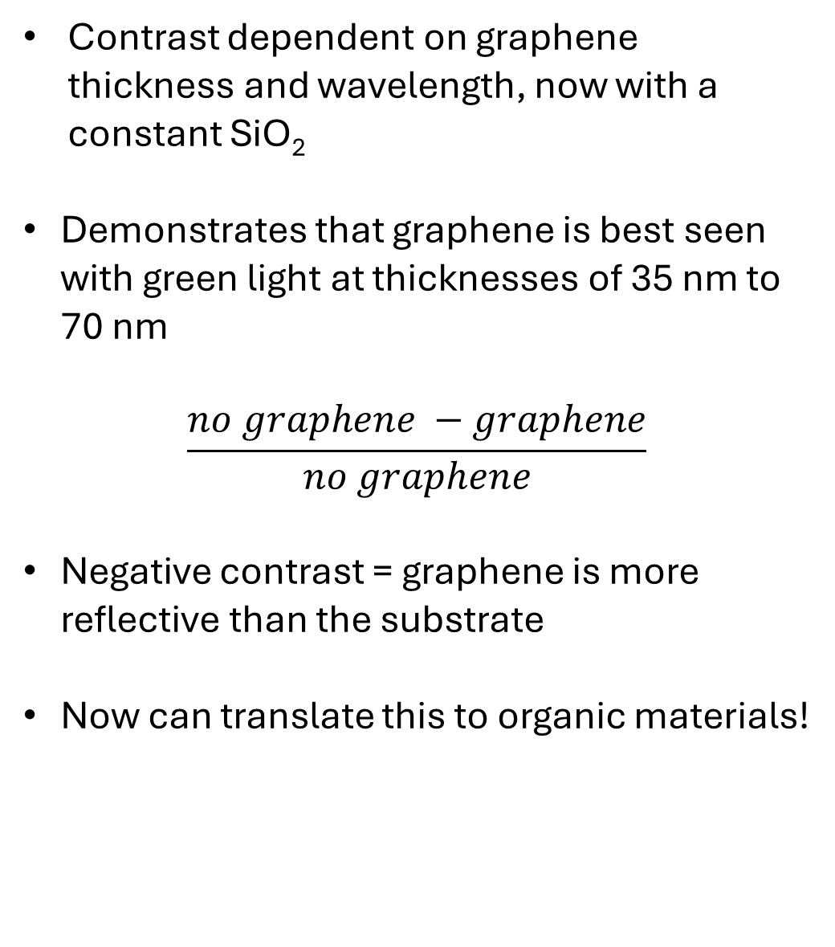
Effect of Graphene Thickness
Contrast dependent on graphene thickness and wavelength, now with a constant SiO₂
Demonstrates that graphene is best seen with green light at thicknesses of 35 nm to 70 nm
$$\frac{no graphene −graphene}{no graphene}$$
Negative contrast = graphene is more reflective than the substrate
Now can translate this to organic materials!
Made by me!

Slide 14
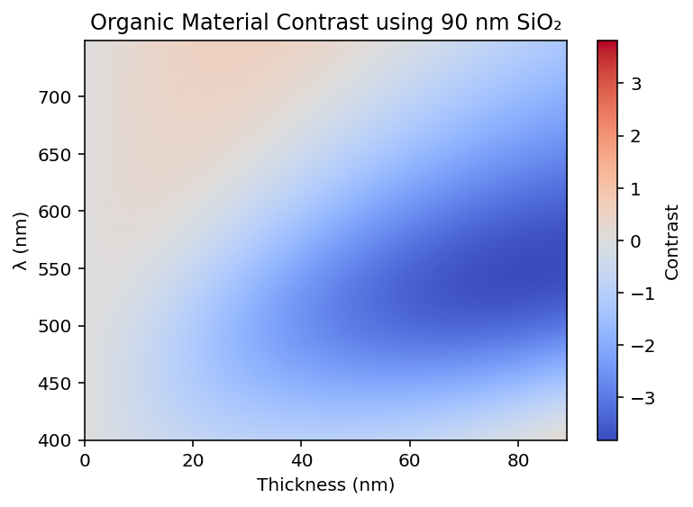
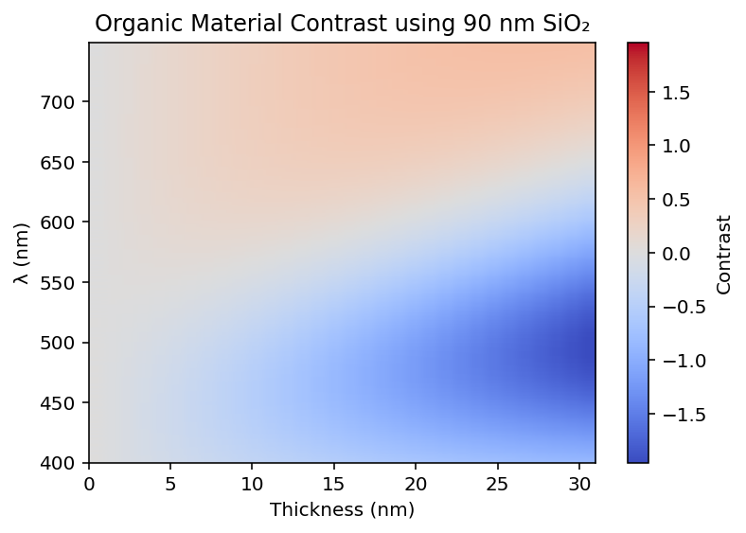
Organic Materials
Assume a non-absorbing organic material with n = 1.7 + 0i
Certain thicknesses paired with specific wavelengths are most optimal for contrast.
Green/yellow light paired with 90nm SiO₂ and 40-100 nm organic thickness
Graphs made by me!

Slide 15
What I’ve Learn This Summer!
Fresnel Equations (both with and without the wave vector)
I’m now a master at Python
How to ask for help
Better social skills
No one expects me to know everything!

Slide 16
Acknowledgements References
Dr. Lloyd Bumm (best mentor ever)
Mikey Walkup
Steven Raybould
P. Blake, E. W. Hill, A. H. Castro Neto, K. S. Novoselov, D. Jiang, R. Yang, T. J. Booth, A. K. Geim; Making Graphene Visible. Appl. Phys. Lett. 6 August 2007; 91 (6): 063124. https://doi.org/10.1063/1.2768624
Wikipedia contributors. (2026, June 26). Fresnel equations. In Wikipedia, The Free Encyclopedia. Retrieved 21:30, July 20, 2026, from https://en.wikipedia.org/w/index.php?title=Fresnel_equations&oldid=1361158557
Wikipedia contributors. (2026, July 12). Transfer-matrix method (optics). In Wikipedia, The Free Encyclopedia. Retrieved 16:39, July 21, 2026, from https://en.wikipedia.org/w/index.php?title=Transfer-matrix_method_(optics)&oldid=1363830099

Slide 17

Questions?

Slide 18

Thank You All So Much! Best Summer Ever! <3

